Slide 1
Greensboro Reservoir Management
Wednesday May 8, 2019
Steven D. Drew
Water Resources Department

Slide 2
Agenda
Water Resources Overview
Greensboro’s Watershed
Reservoirs
Water Treatment Plants
Lake Operation
Haw River Pump Station
System Interconnections
Water Distribution System

Slide 3
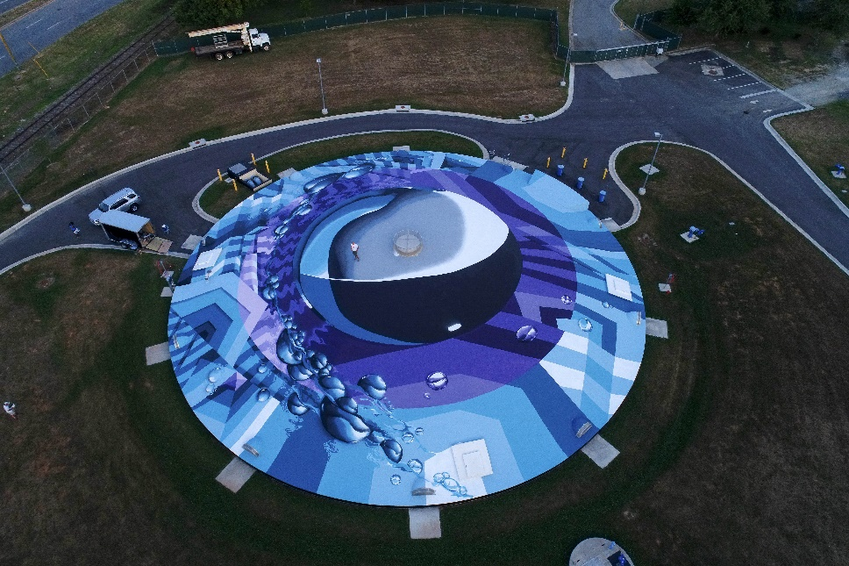
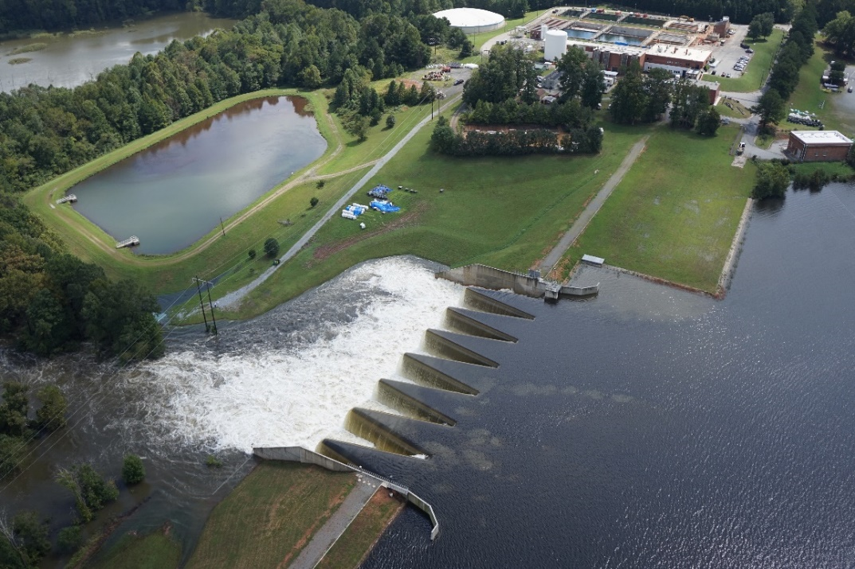
Greensboro Water Resources
355 employees
104,000 water accounts
Provide Water, Wastewater, and Stormwater Services
Two water treatment plants
1,520 miles of public water lines
2017 Avg. Water Demand 33.4 MGD
Notes:
Picture of Townsend WTP – Tropical Storm Florence
285,000+ residents
Divisions
Business
Customer Service
Engineering
Operations
Stormwater
Water Reclamation
Water Supply
Departmental Budget Information
FY19 Water and Sewer Utility: $134,372,479
FY19 Stormwater Utility: $13,535,896

Slide 4
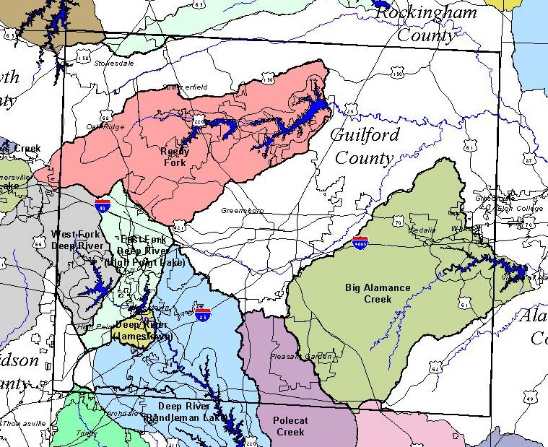
Greensboro’s Watershed
Notes:
Drinking Water Reservoirs located within the Reedy Fork Drainage Basin. Three man-made impoundments: Lake Higgins (11.6 mi² drainage area), Lake Brandt (68 mi²) and Lake Townsend (105 mi²).

Slide 5
Source Water: Brandt, Higgins and Townsend
Notes:
City owns and maintains a riparian buffer around all three reservoirs. On average, both plants treat and deliver about 33.4 million gallons per day to more than 285,000 residents. When full, Greensboro’s three water reservoirs hold approximately nine billion gallons of water.
Wading, bathing, or swimming are prohibited in Lakes Higgins, Brandt, and Townsend.

Slide 6
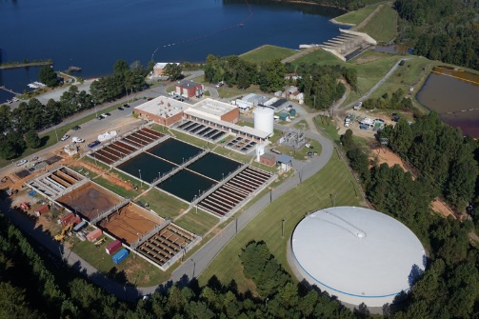
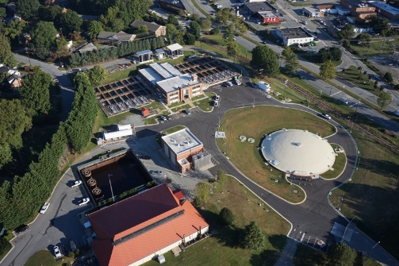
Water Treatment Plants
Lake Townsend Water Treatment Plant (built in 1968) rated at 30 MGD
Mitchell WTP (built in 1958) rated at 24 MGD
Lake Townsend Water Treatment Plant
Mitchell Water Treatment Plant
Notes:
CIP projects ongoing and planned for both plants. Major electrical upgrades for both in the near future and Townsend nearing completion (6/2019) of sedimentation basin and filter (air scour) upgrades.
Mitchell GAC, sedimentation (plate settlers) and residuals management design upgrades scheduled to begin in FY20.

Slide 7
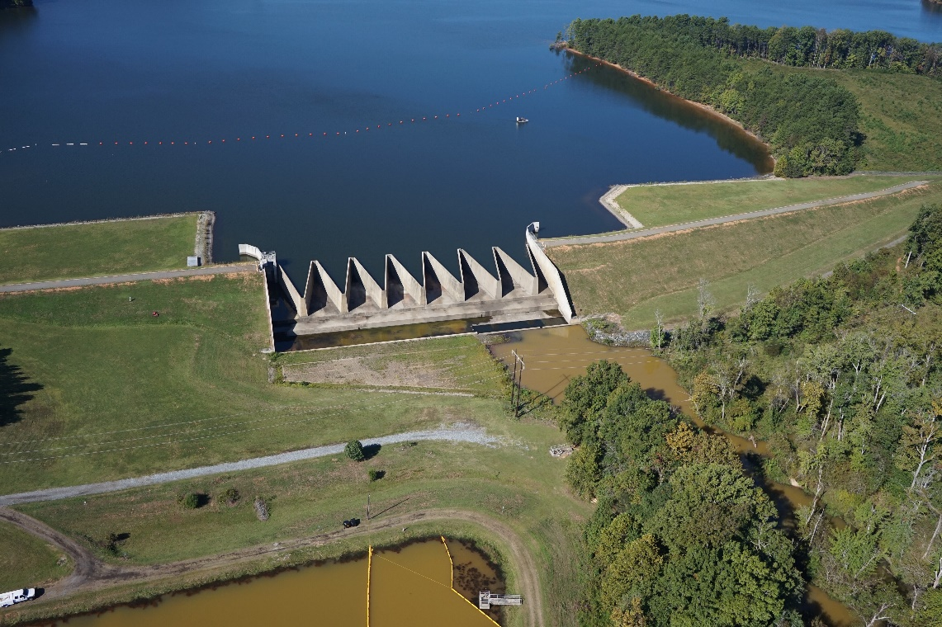
Lake Townsend Reservoir
Labyrinth Spillway
Built in 2010
Spillway Capacity - 60% PMP
2 cycles at normal pool and 5 cycles at one foot above normal pool (EL 716.5)
Design accounts for failure of upstream dams (Higgins and Brandt)
Three-Tiered Minimum Release Schedule
Top Tier – Minimum of 7 cfs to Reedy Fork (dam and plant flow)
Middle - $≥$ 3.5 cfs and Stage I Water Restrictions in effect
Bottom Tier – Min. 2 cfs and Stage V Water Restrictions in effect
Notes:
Release Schedule Approved by State and implemented in 3/2014
Middle Tier Lake Level also less than 714.5 MSL
Bottom Tier Lake Level also less than 709.7 MSL

Slide 8
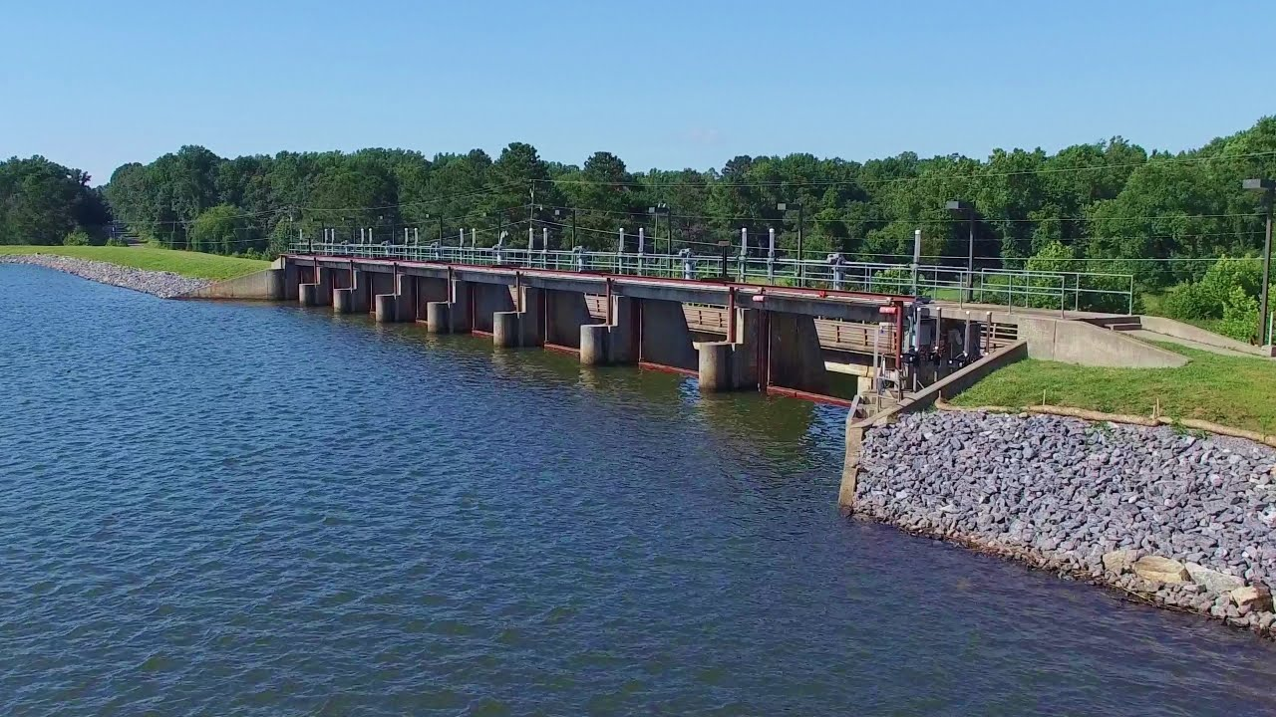
Lake Brandt Reservoir
Gated Concrete (Ogee) Spillway and Sluiceway
Constructed in 1960
Spillway Capacity - 40% of PMP
Eight vertical roller gates (25’ W x 10’ H) operated from bridge deck
Lake level kept 6” to 12” below normal pool prior to wet weather events
Gates operated (spillway rating table) to match inflow with outflow
Notes:
Original spillway failed in 1947 (flood of record for Reddy Fork Creek) and replaced with existing structure (raised normal pool 7 feet) and pump station to provide raw water to Mitchel Water Treatment Plant.

Slide 9
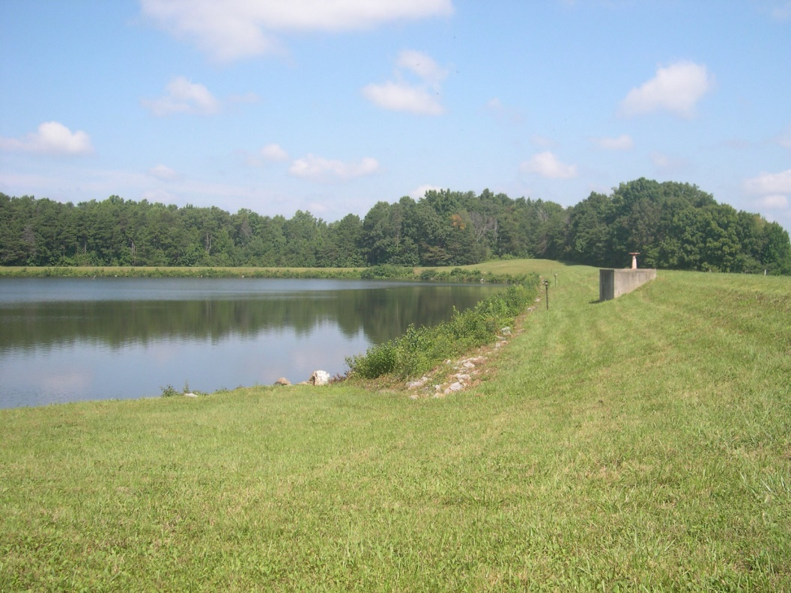
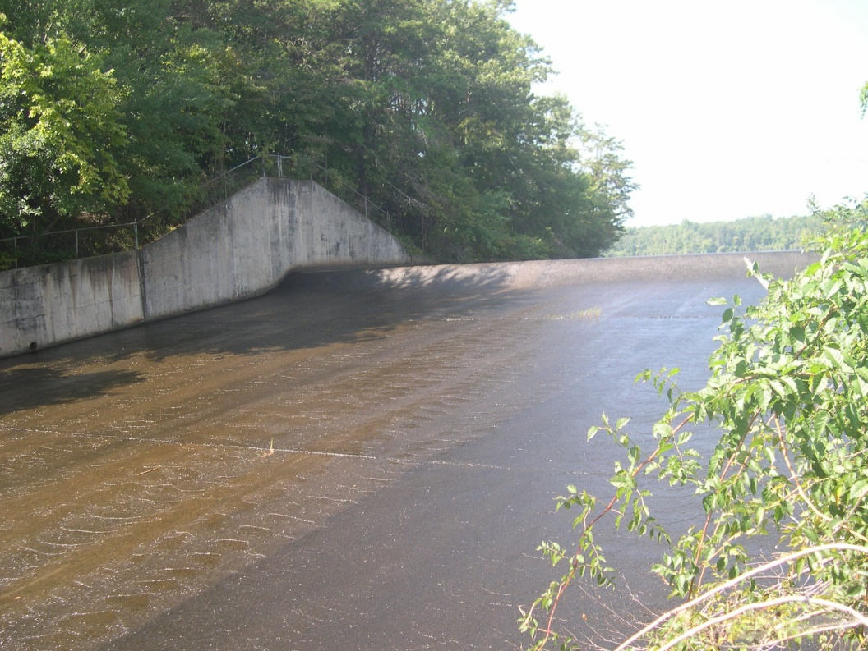
Lake Higgins Reservoir
Concrete Ogee Spillway
Constructed in 1956 to raise dam over existing earthen embankment
Fixed Elevation Spillway - primary means of controlling lake level
Earthen Auxiliary Spillway
Maximum Discharge – 39,100 cfs
Notes:
Normal Pool Elevation – 741.5 ft.
Lake can be drained using bottom drain pipe and isolation valve.

Slide 10
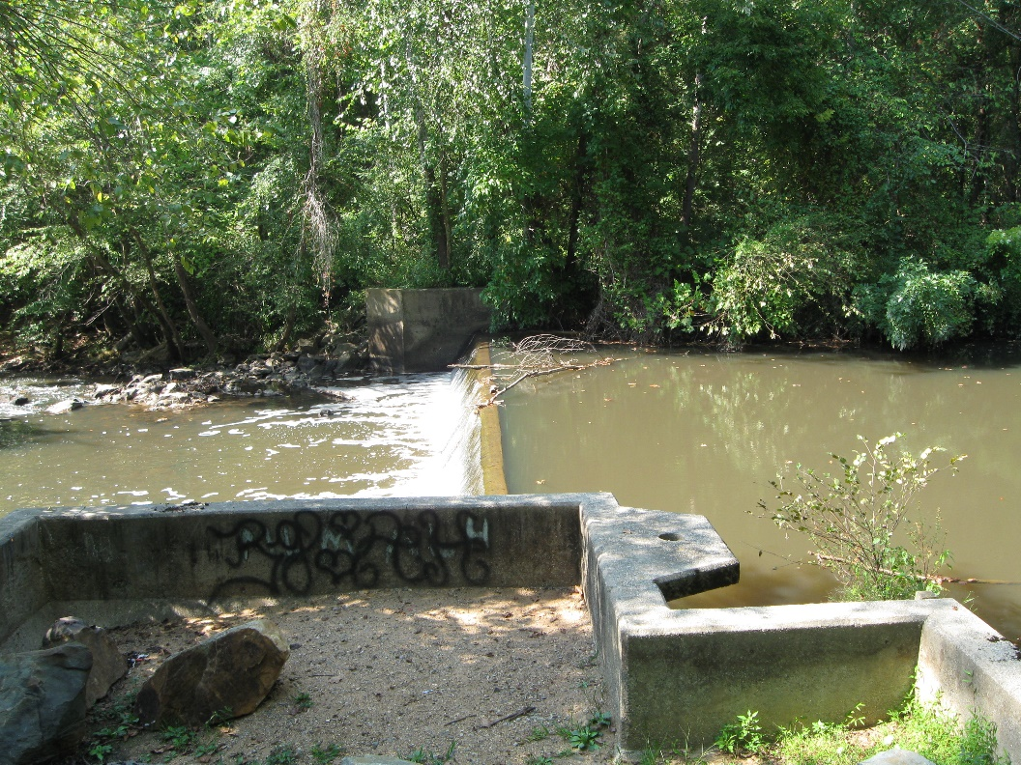
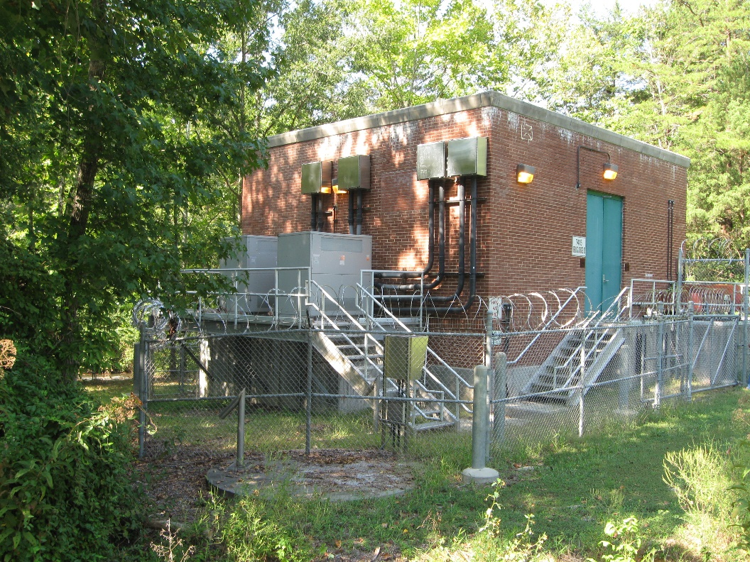
Haw River Pump Station
Station Usage Triggered By City Reservoir Usable Storage
Drought Risk Rule Curve (below which reservoir will not be filled by April of any given year)
Stage 2 Water Restrictions in effect
Stream flow greater than 3” over dam
Two 500 HP Raw Water VFD Pumps – 4 to 12 MGD rated capacity
Notes:
Curve takes into account reservoir level as well as flow data, minimum release criteria, and rainfall each month .

Slide 11
Greensboro’s Interconnections
Vital component of Greensboro’s strategy to achieve system resiliency, redundancy, and operational flexibility
Reidsville
Winston-Salem
Burlington
Greensboro
High Point
Jamestown
PTRWA
Notes:
City’s water supply was susceptible to long droughts because the reservoir system was designed to capture (for public water supply) more than half of the available watershed runoff (53% without taking into consideration the interconnected flows shown in the slide)
PTRWA interconnect – 6.736 MGD
Reidsville – 1 MGD
Burlington – 1.5 to 5 MGD
Winston-Salem – 0 to 3 MGD intermittent / emergency (free chlorine)
City of High Point – 0 to 1.5 MGD emergency only
Water quality at each interconnect must meet all regulatory requirements and compliance standards

Slide 12
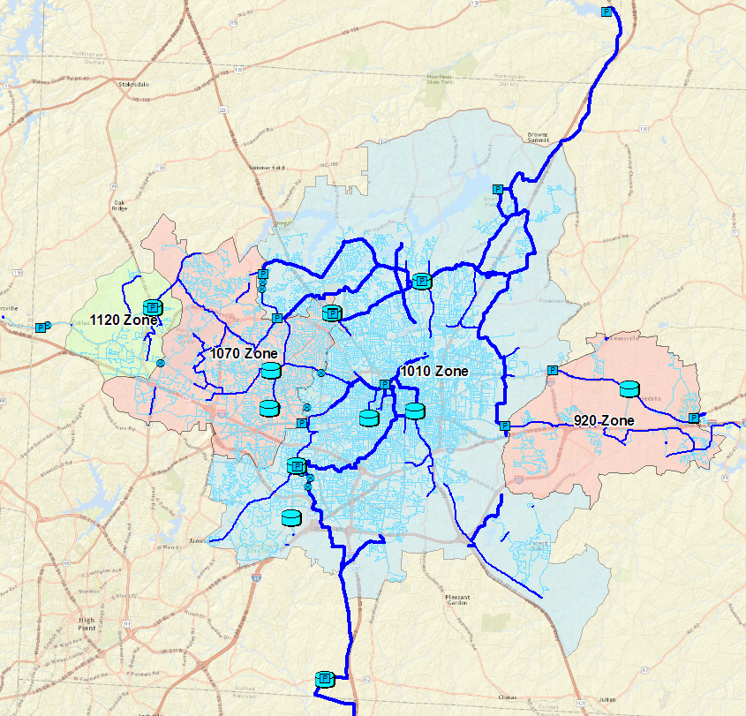
Water Distribution System
Supply from
Reidsville
Supply from
Winston-Salem
Supply from
Burlington
Supply from
PTRWA
Notes:
Four pressure zones and label based on highest tank overflow elevation.

Slide 13
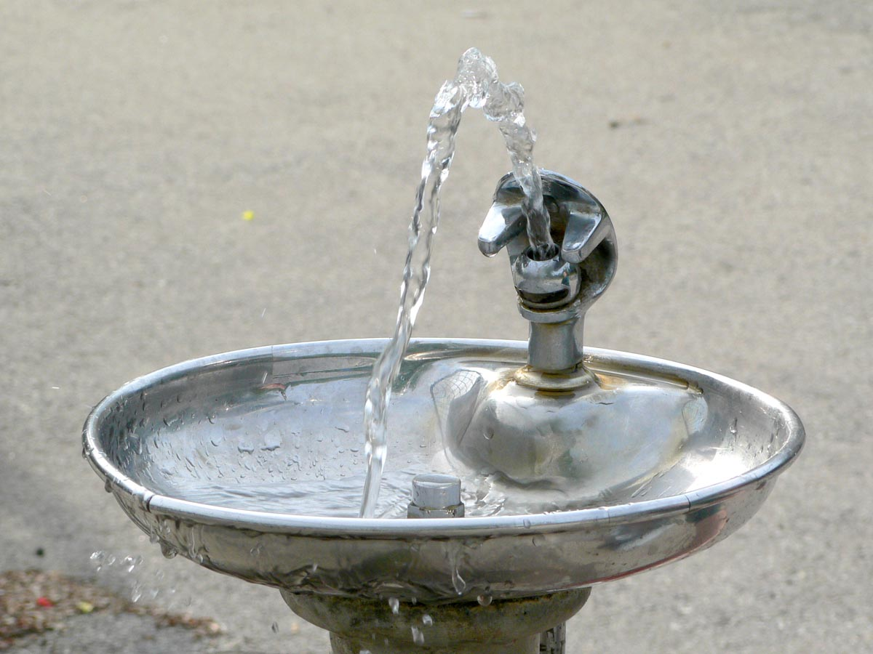
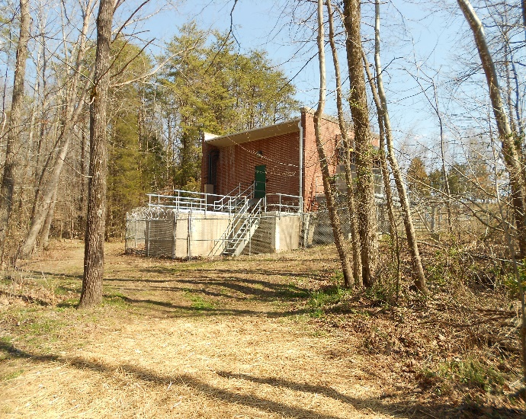
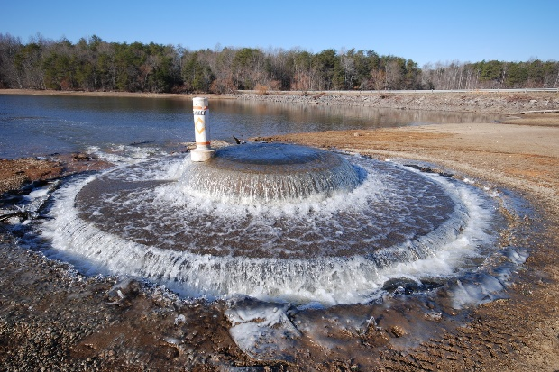
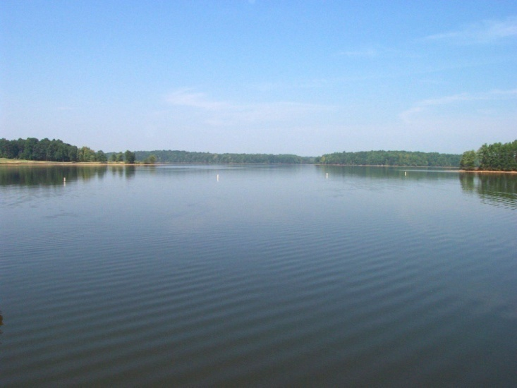
Questions?

